Slide 1

Used car value analysis
Alec Henderson, Andrew Paton, British Green, Vilma Diaz

Slide 2
01
Problem Statement & Hypothesis
02
Sedan Supply and Demand Analysis
Presentation
Agenda
03
Trucks Regression Analysis
04
Closing Thoughts
05
Questions

Slide 3
Executive Summary
Through this study, we evaluate which economic drivers influence car values the most. We hypnotize that scarcity causes greater variability in car value than mileage.
01
02
03
Data Source
Cleaning Data
Data Analysis
Our data source features over 5.7 million records of car sales in Illinois over the time period of 2018-2020
We cleaned the data by splitting it into two groups (Sedans, Pickup Trucks). From there we removed all outliers for both price and mileage. Further reduction to the data set was made by dropping columns that had less than 95% missing records.
We preformed both a volume to price analysis and mileage to price regression to analyze their effect on resale price

Slide 4
Supply & Demand
The Fundamentals That Effect Price
Law of demand
supply
The claim that all else equal, when price goes up the quantity demanded will decrease.
Decreased supply
When the supply is decreased the price of the good will increase. Those with a higher consumer surplus will be willing to purchase the good.
q
Equilibrium point
The point were the supply line meets the demand line. Represented as point Q.
demand

Slide 5
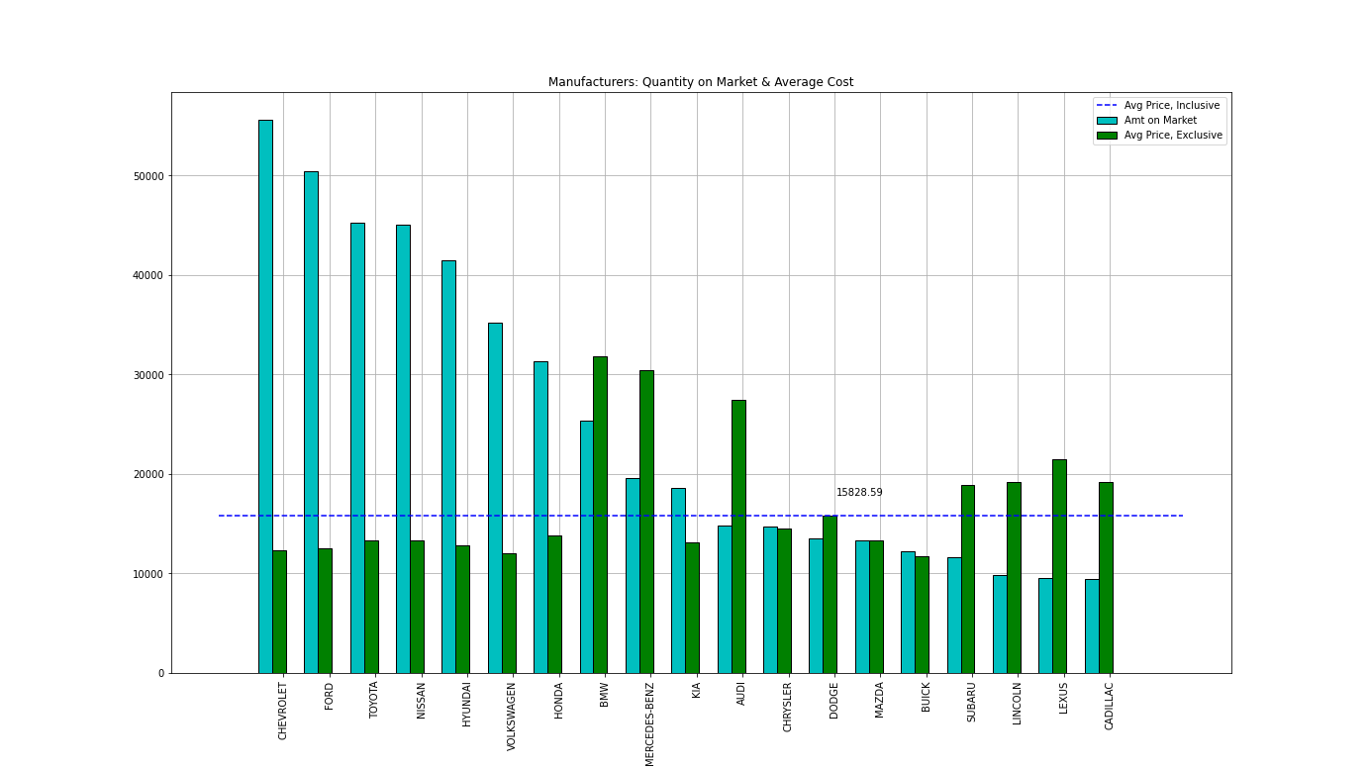
Brand popularity
Volume Analysis by Used Car Sales
X-Axis
Represents both the car volume sold and average price.
Y-Axis
Categorical listing of different brands
Key take-away
The higher the supply the lower the price demanded for the car.

Slide 6
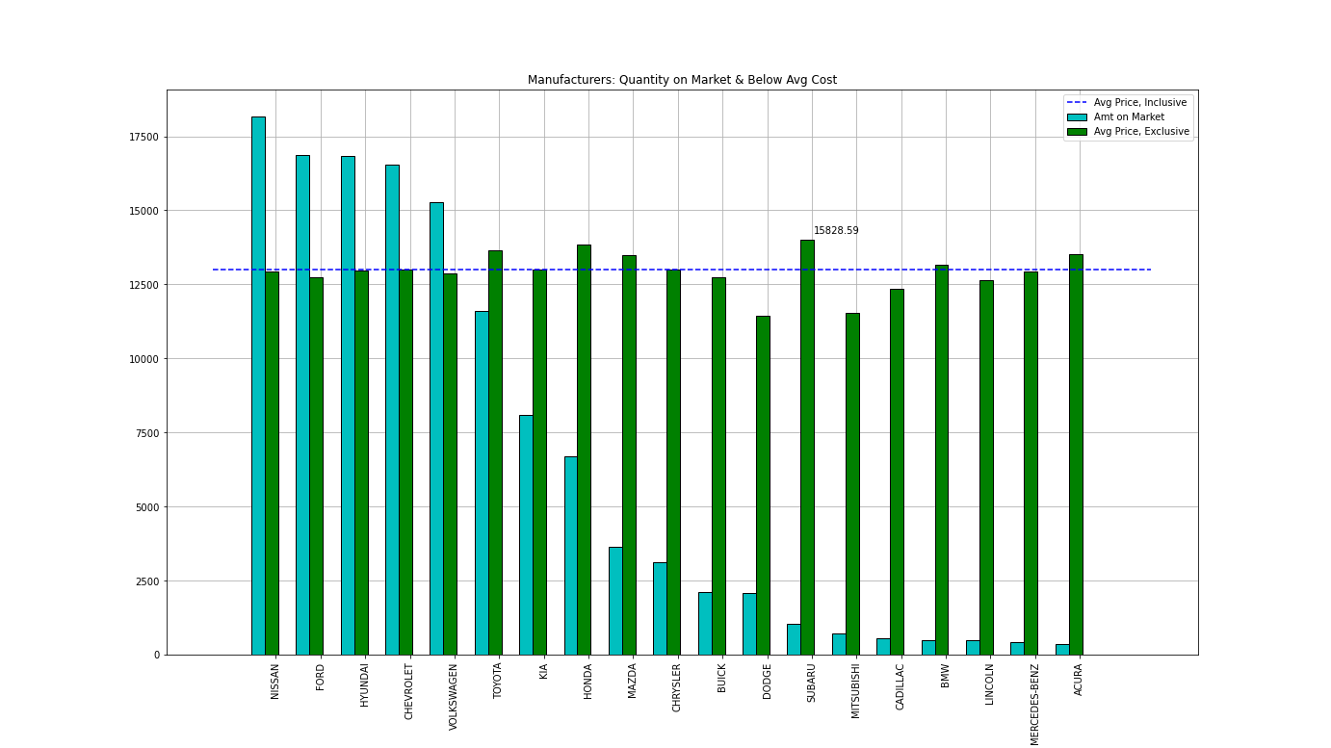
Brand popularity
Continued
?
?
?
?
?
?

Slide 7
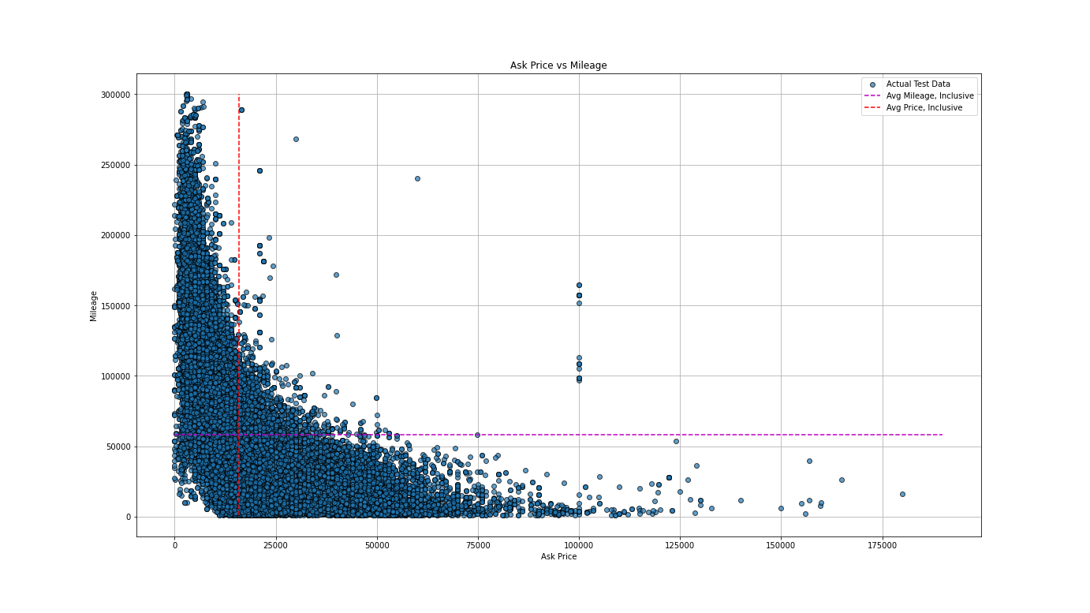
mileage on Sedans
Scatter Plot Analysis on Mileage on Sedans and Corresponding Price
Findings
By generating a complete scatter plot of all Sedans, we find that mileage negatively correlates with price. Considering the variability of sedans and features, we have further broken down pickup trucks into segments to perform regression analyses.

Slide 8
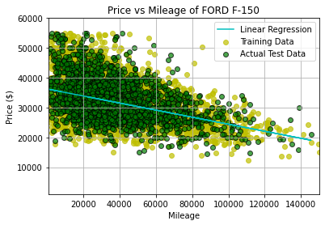
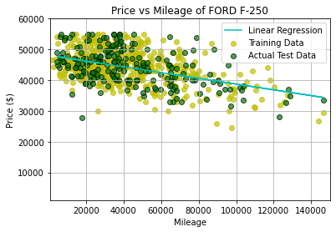
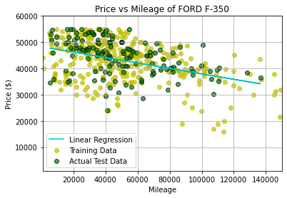
Ford regressions
Model: Ford F-150
Fuel: Gasoline
Records: 9197
R^2: 0.155889
Y= -0.12X + 36,267.72
$0.12 Drop for Every Mile
Model: Ford F-250
Fuel: Diesel
Records: 699
R^2: 0.230075
Y= -0.09X + 48,097.43
$0.09 Drop for Every Mile
Model: Ford F-350
Fuel: Diesel
Records: 9197
R^2: 0.1507034
Y= -0.10X + 48,289.00
$0.10 Drop for Every Mile
Notes:
The Overall Accuracry of the Model is: 17.71% The R^2 Value of the Linear Regression Model is: 0.15588960825002385 The Linear Equation of the Regression is: Y=-0.12X + 36,267.72 For Every Mile Driven The Value of the Truck Drops by: $-0.12 Number of Records: 9197
The Overall Accuracry of the Model is: 19.82% The R^2 Value of the Linear Regression Model is: 0.23007534933926088 The Linear Equation of the Regression is: Y=-0.09X + 48,097.43 For Every Mile Driven The Value of the Truck Drops by: $-0.09 Number of Records: 699
The Overall Accuracry of the Model is: 17.79% The R^2 Value of the Linear Regression Model is: 0.15070341603576776 The Linear Equation of the Regression is: Y=-0.10X + 48,289.00 For Every Mile Driven The Value of the Truck Drops by: $-0.10 Number of Records: 482

Slide 9
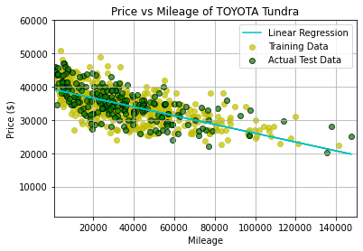
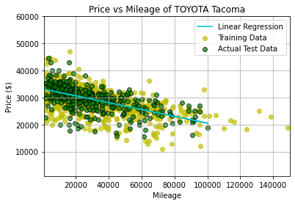
Toyota regressions
Model: Toyota Tundra
Fuel: Gasoline
Records: 718
R^2: 0.4426497
Y= -0.13X + 39,270.17
$0.13 Drop for Every Mile
Model: Ford F-250
Fuel: Gasoline
Records: 1251
R^2: 0.3457739
Y= -0.13X + 33,203.86
$0.13 Drop for Every Mile
Notes:
The Overall Accuracry of the Model is: 42.48% The R^2 Value of the Linear Regression Model is: 0.44264975534088935 The Linear Equation of the Regression is: Y=-0.13X + 39,270.17 For Every Mile Driven The Value of the Truck Drops by: $-0.13 Number of Records: 718
The Overall Accuracry of the Model is: 36.13% The R^2 Value of the Linear Regression Model is: 0.3457739500863438 The Linear Equation of the Regression is: Y=-0.13X + 33,203.86 For Every Mile Driven The Value of the Truck Drops by: $-0.13 Number of Records: 1251

Slide 10
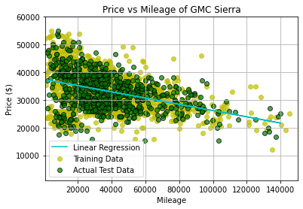
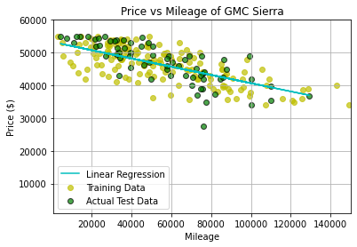
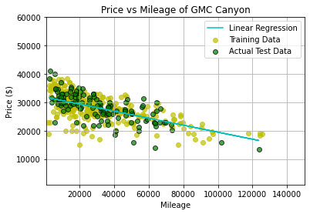
gmc regressions
Model: GMC Sierra
Fuel: Gasoline
Records: 2427
R^2: 0.1560222
Y= -0.11X + 37,442.27
$0.11 Drop for Every Mile
Model: GMC Sierra
Fuel: Diesel
Records: 225
R^2: 0.54774453
Y= -0.13X + 53,292.70
$0.13 Drop for Every Mile
Model: GMC Canyon
Fuel: Gasoline
Records: 429
R^2: 0.4764506
Y= -0.12X + 31,886.33
$0.12 Drop for Every Mile
Notes:
The Overall Accuracry of the Model is: 14.99% The R^2 Value of the Linear Regression Model is: 0.15602227676940383 The Linear Equation of the Regression is: Y=-0.11X + 37,442.27 For Every Mile Driven The Value of the Truck Drops by: $-0.11 Number of Records: 2427
The Overall Accuracry of the Model is: 50.24% The R^2 Value of the Linear Regression Model is: 0.5477445358596613 The Linear Equation of the Regression is: Y=-0.13X + 53,292.70 For Every Mile Driven The Value of the Truck Drops by: $-0.13 Number of Records: 225
The Overall Accuracry of the Model is: 39.12% The R^2 Value of the Linear Regression Model is: 0.47645067224759263 The Linear Equation of the Regression is: Y=-0.12X + 31,886.33 For Every Mile Driven The Value of the Truck Drops by: $-0.12 Number of Records: 429

Slide 11
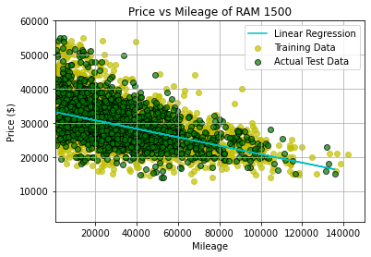
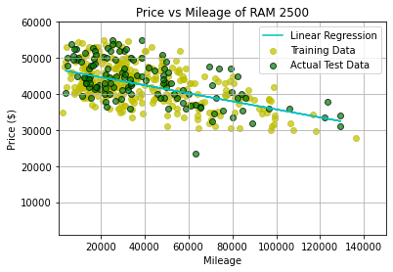
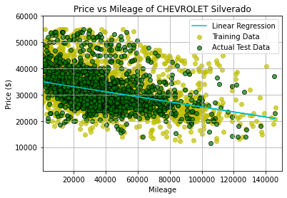
Ram & Chevrolet regressions
Model: RAM 1500
Fuel: Gasoline
Records: 6043
R^2: 0.2431693
Y= -0.12X + 33,270.29
$0.12 Drop for Every Mile
Model: RAM 2500
Fuel: Diesel
Records: 431
R^2: 0.301619
Y= -0.11X + 46,908.27
$0.11 Drop for Every Mile
Model: Chevy Silverado
Fuel: Gasoline
Records: 5249
R^2: 0.1201091
Y= -10X + 34,993.23
$0.10 Drop for Every Mile
Notes:
The Overall Accuracry of the Model is: 21.70% The R^2 Value of the Linear Regression Model is: 0.2431693117546193 The Linear Equation of the Regression is: Y=-0.12X + 33,270.29 For Every Mile Driven The Value of the Truck Drops by: $-0.12 Number of Records: 6043
The Overall Accuracry of the Model is: 27.99% The R^2 Value of the Linear Regression Model is: 0.3016192342466538 The Linear Equation of the Regression is: Y=-0.11X + 46,908.27 For Every Mile Driven The Value of the Truck Drops by: $-0.11 Number of Records: 431
The Overall Accuracry of the Model is: 11.81% The R^2 Value of the Linear Regression Model is: 0.12010916915134684 The Linear Equation of the Regression is: Y=-0.10X + 34,993.23 For Every Mile Driven The Value of the Truck Drops by: $-0.10 Number of Records: 5249

Slide 12
regression findings
Rankings of the Top 5 and Key Take-Aways
Cost per Mile
R^2 Value
Findings
01
Ford f-250
Gmc sierra
Challenges
While all trucks examined show a negative correlation between price and mileage, the R squared value is too low to consider this statistically significant. Further all trucks examined have a negative slope range of only 4 cents. The most shallow slope being -0.09 and the most steep being -0.13. It is unclear what brand and model retains their value the best given the nearly identical slopes and low R squared values.
Trends
However we can identify trends from the data. First, it is clear that Diesel trucks hold their value better over time than Gasoline trucks. This may be explained by the engine life expectancies. Second, we can conclude that the higher the starting price the steeper the slope of the regression line.
$ 0.09 per mile
0.547744
02
Ford f-350
Gmc canyon
$0.10 per mile
0.476450
03
Ch. silverado
Toyota tundra
$0.10 per mile
0.442649
04
Ram 2500
Toyota tacoma
$0.11 per mile
0.345773
05
Gmc sierra
Ram 2500
$0.11 per mile
0.301619

Slide 13
Challenges & suggestions
Concluding Our Study We Will Speak on Our Challenges and How to Improve The Study
more Categories
Missing data in records
We suggest that more categories be used in regression models to separate the highly expensive trim cars from the budget trim cars. Mixing these results gave us a high variability in starting price.
Of the 156 columns less than 1/8 had 95% complete data. This left us with a high amount of records with few identifiers.
Nationwide
Mislabeled categories
Use a web scraping program to pull current data from across the untied states. This will both lessen the regional impact as well as provide complete data.
Within the identify columns, we had mislabeled or record entries that were of no use to the study.
Model year
Initial data size
Only compare the same model and model year in the regression model to eliminate design updates.
The data was originally stored in a 5.7GB .CSV file. This was too large to handle by laptop. Therefore we needed to chunk this into several smaller files. Should a web scrapping program be used or an API, it would be more manageable.

Slide 14
questions

